Slide 1
Xilinx GPIO Interrupt example

Slide 2
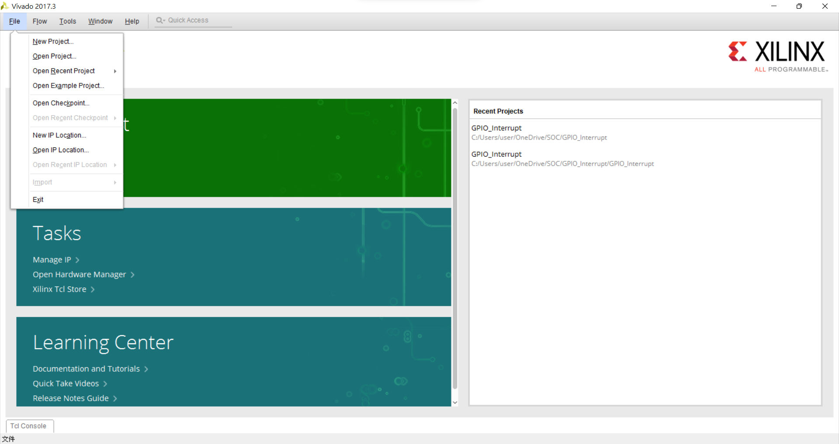
File->New Project

Slide 3

Next

Slide 4
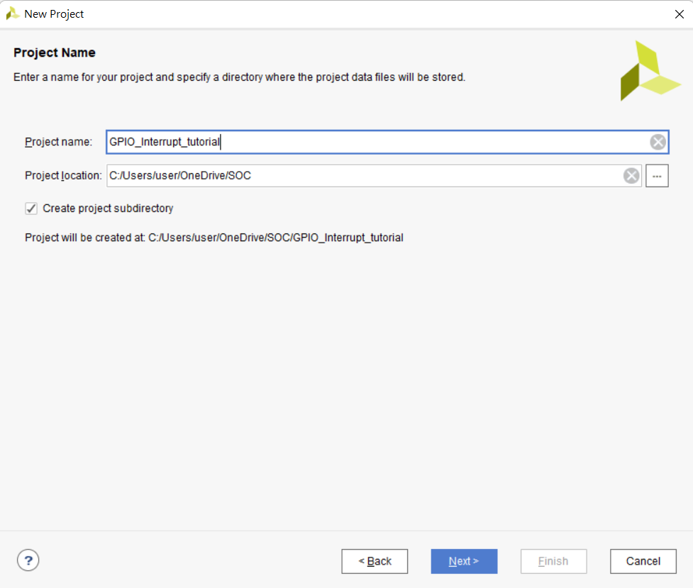
Project name :
設定專案名稱
Project location:
設定專案路徑
Create project subdirectory:
設定專案路徑
設定完後按Next

Slide 5
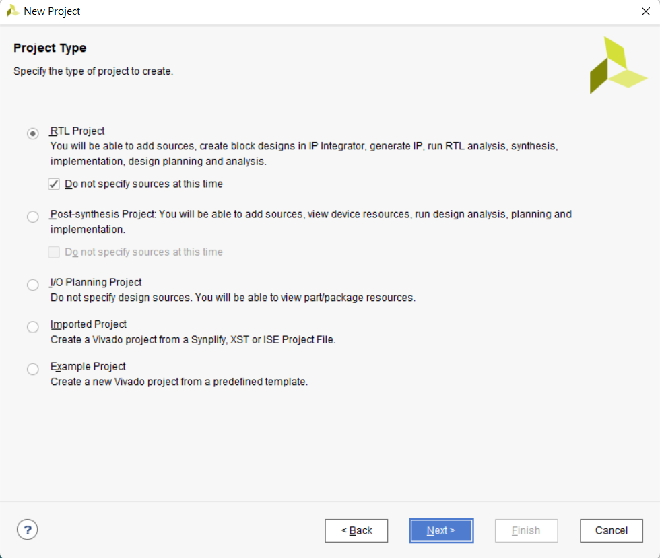
Select Project Type
選擇RTL Project
不指定Sources
選擇後按下一步

Slide 6
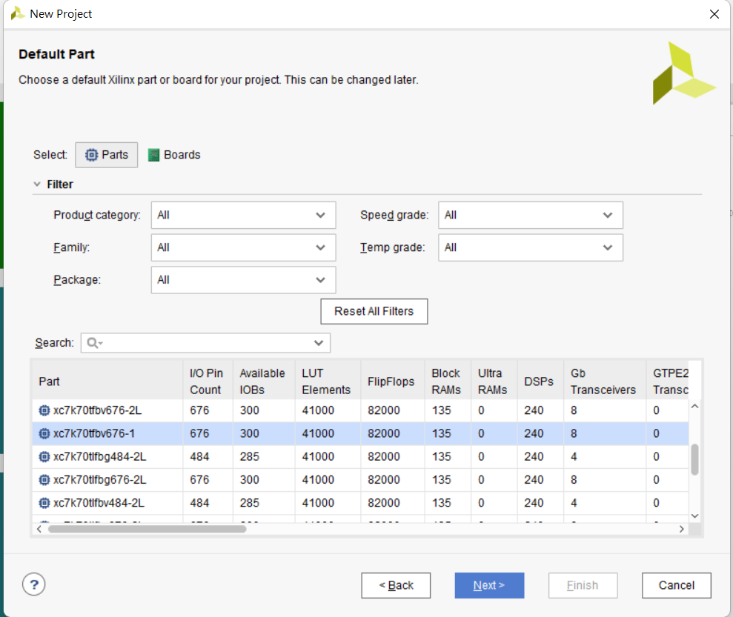
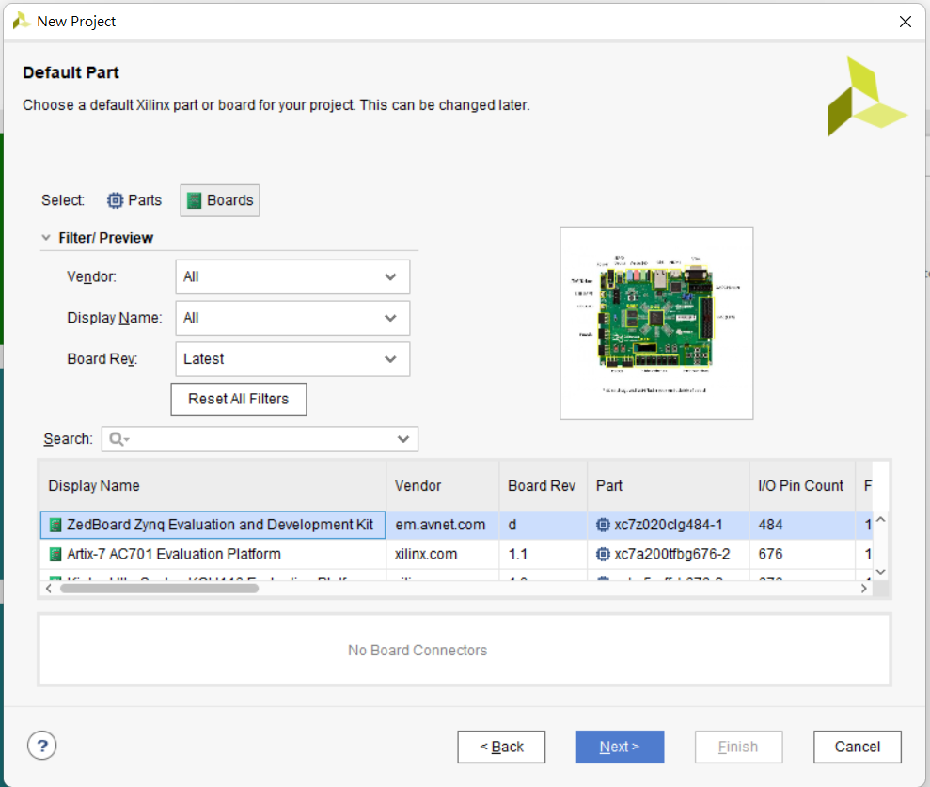
Select your board
選擇Board->Zedbord Zynq Evaluation and Development Kit
選擇完畢後 Next

Slide 7
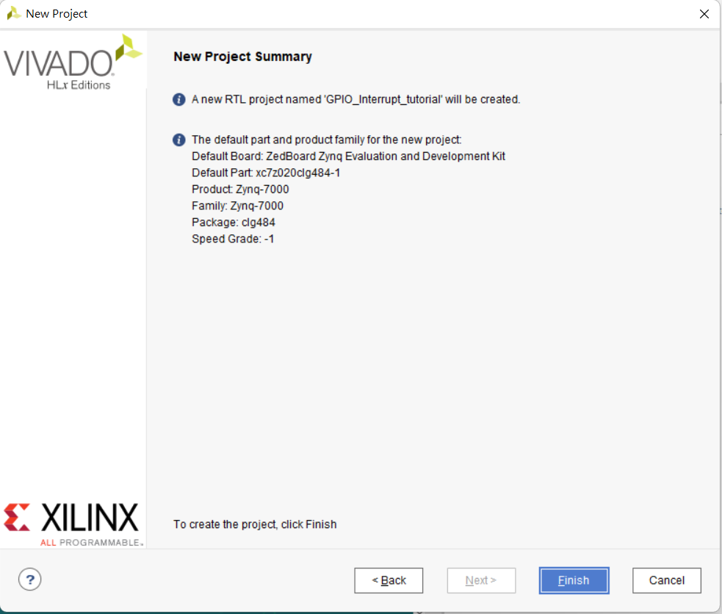

Slide 8
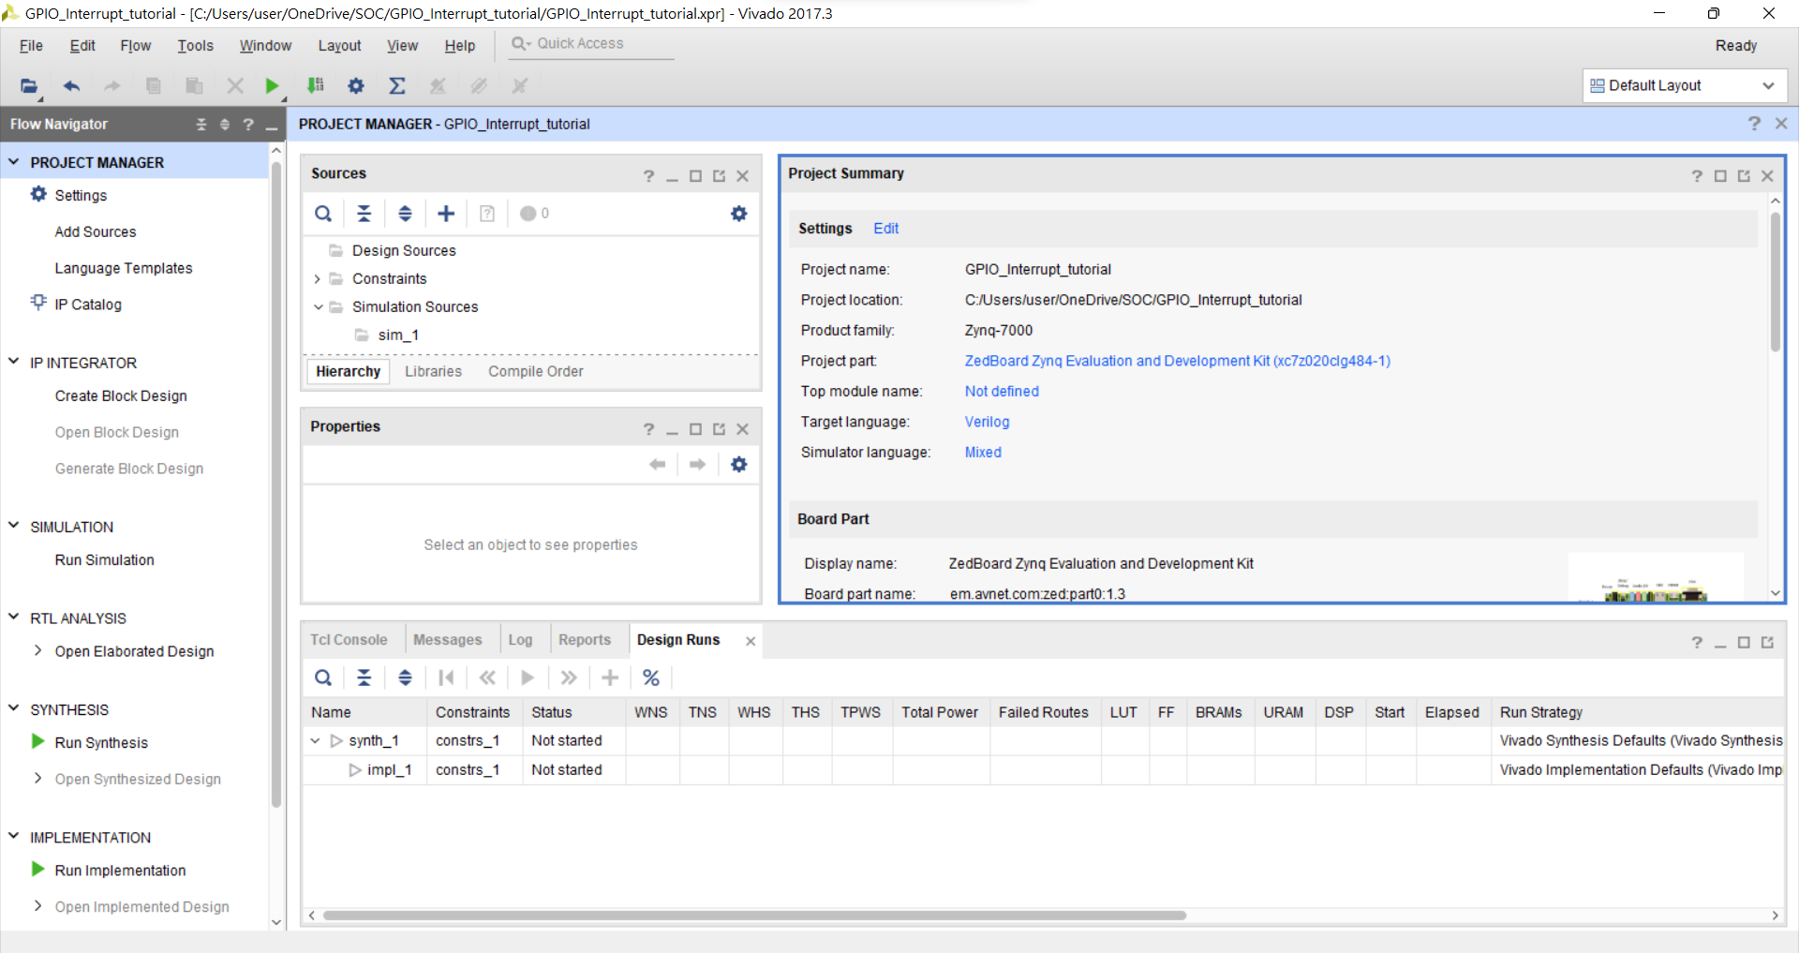
IP INTEGRATOR →Create Block Design

Slide 9
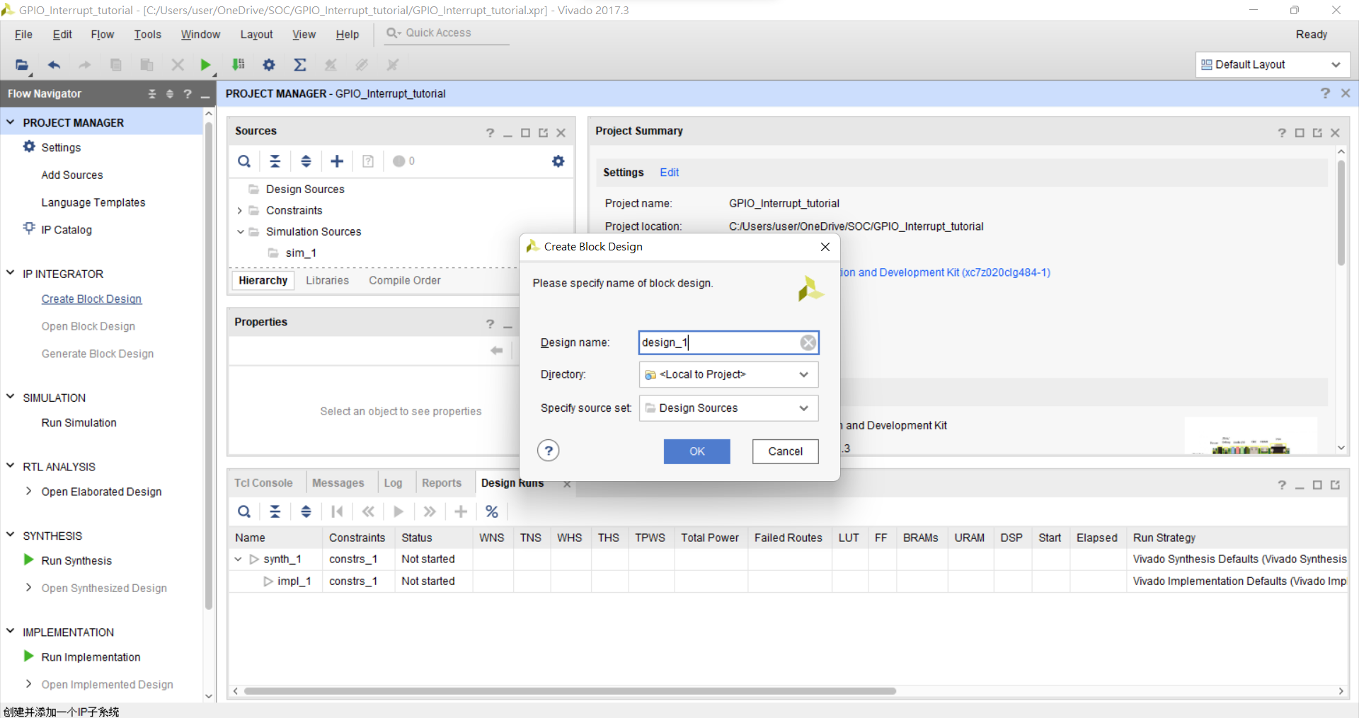

Slide 10
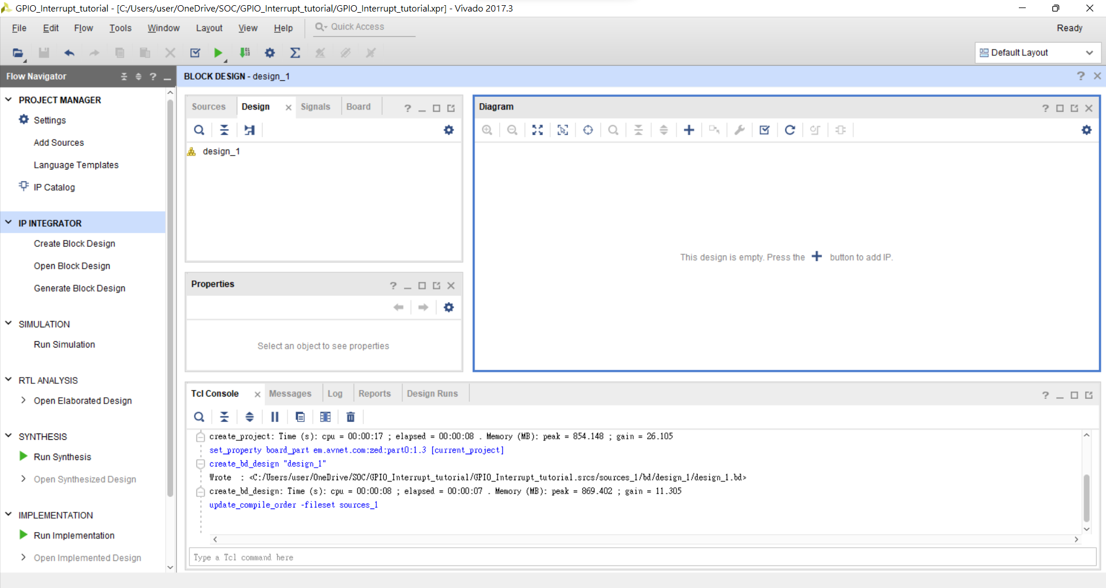
Add IP

Slide 11
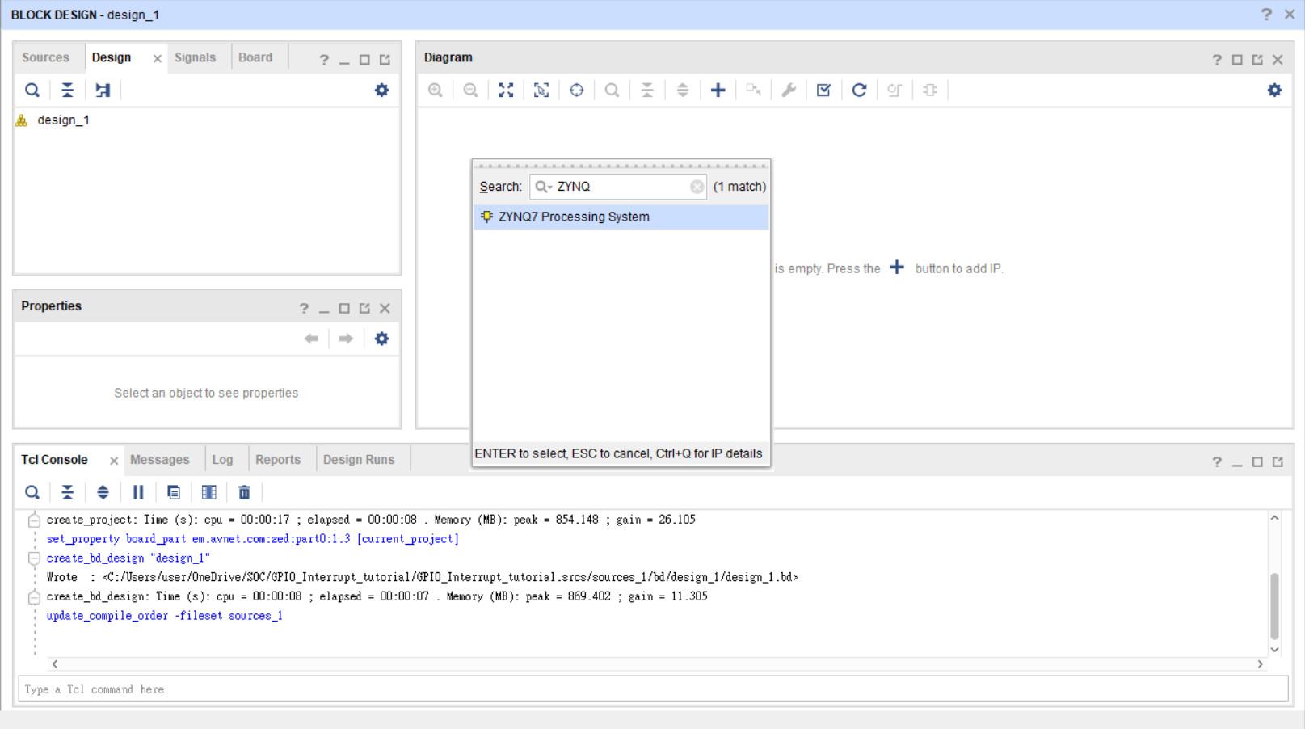
Add PS(Processing system)

Slide 12
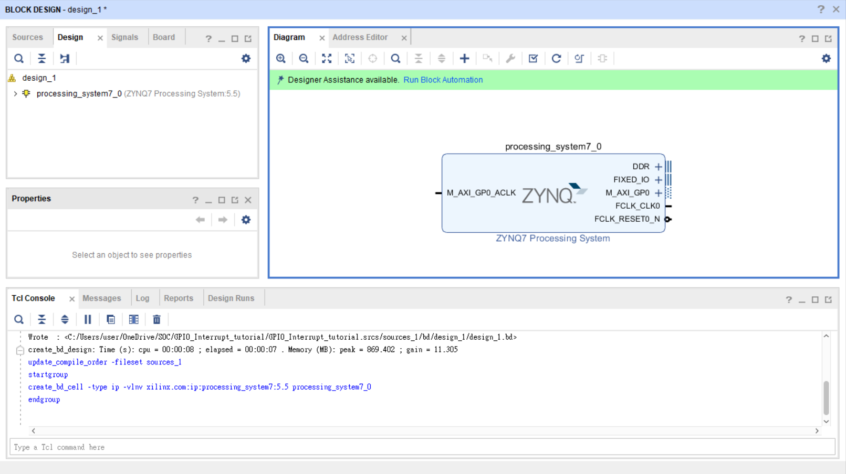
Run block Automation

Slide 13
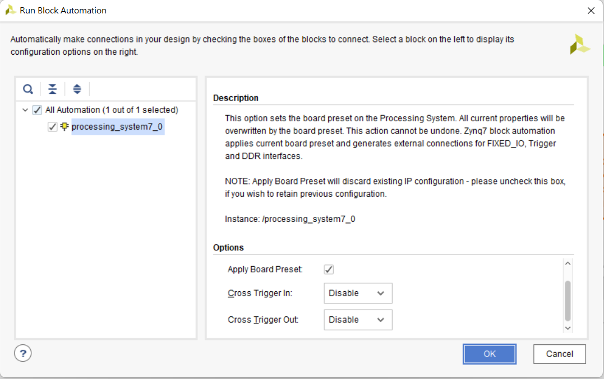
確認完畢後按OK

Slide 14
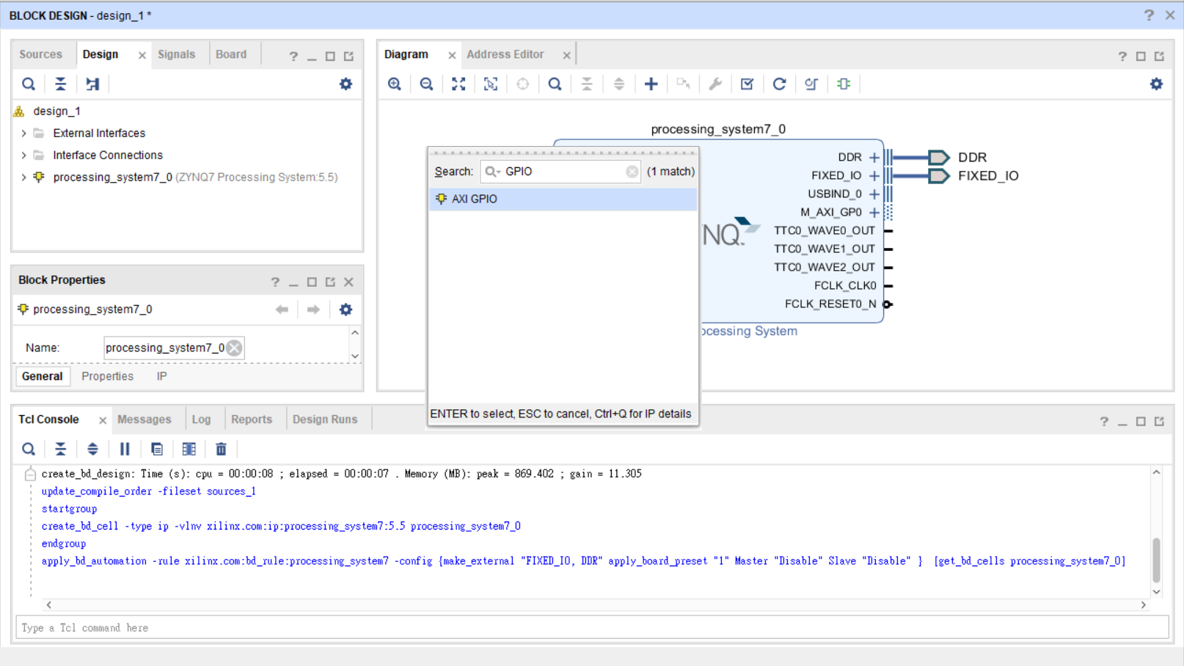
Add two GPIO IP

Slide 15
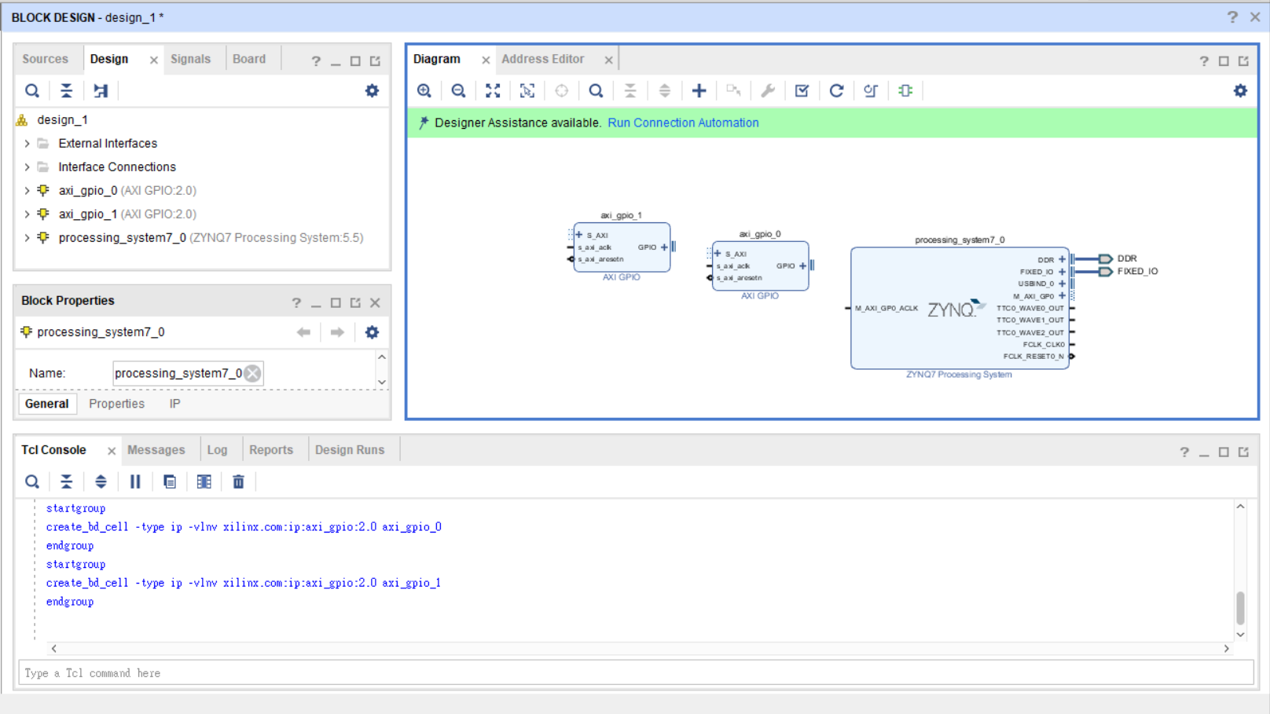
兩個GPIO IP

Slide 16
Setting IP connect

Slide 17
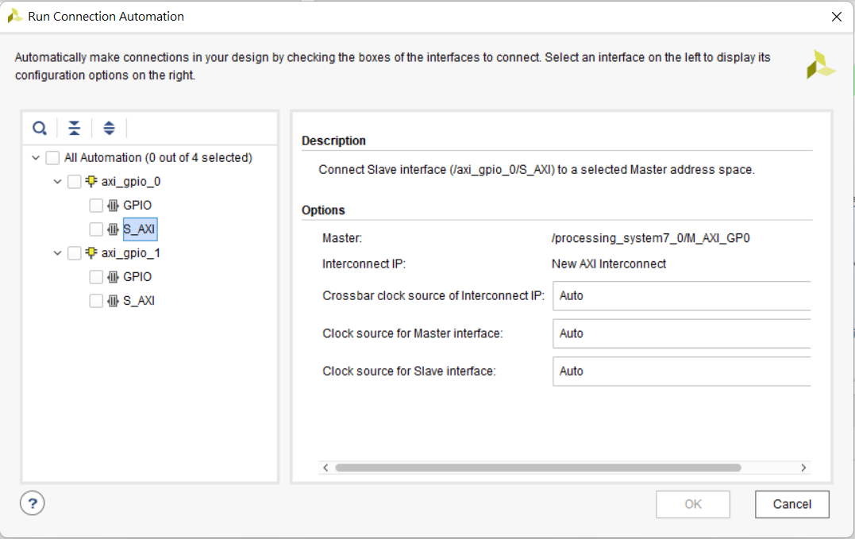
Setting GPIO AXI
皆為Auto

Slide 18
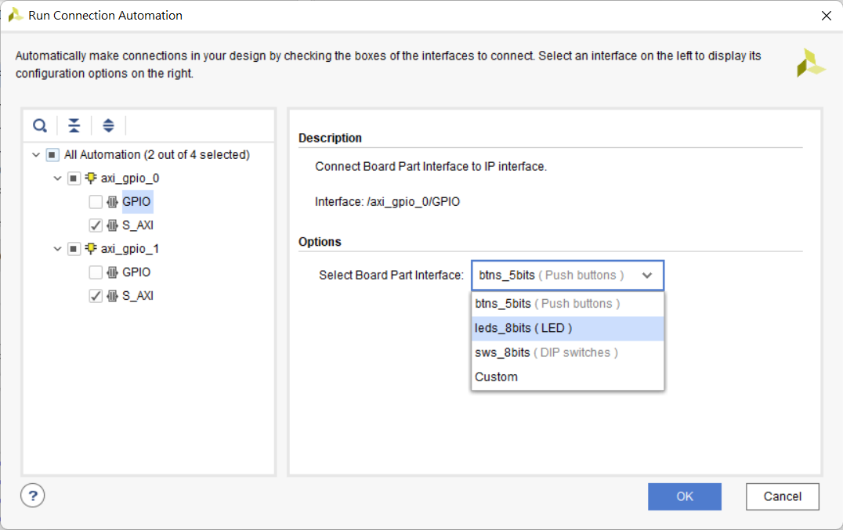
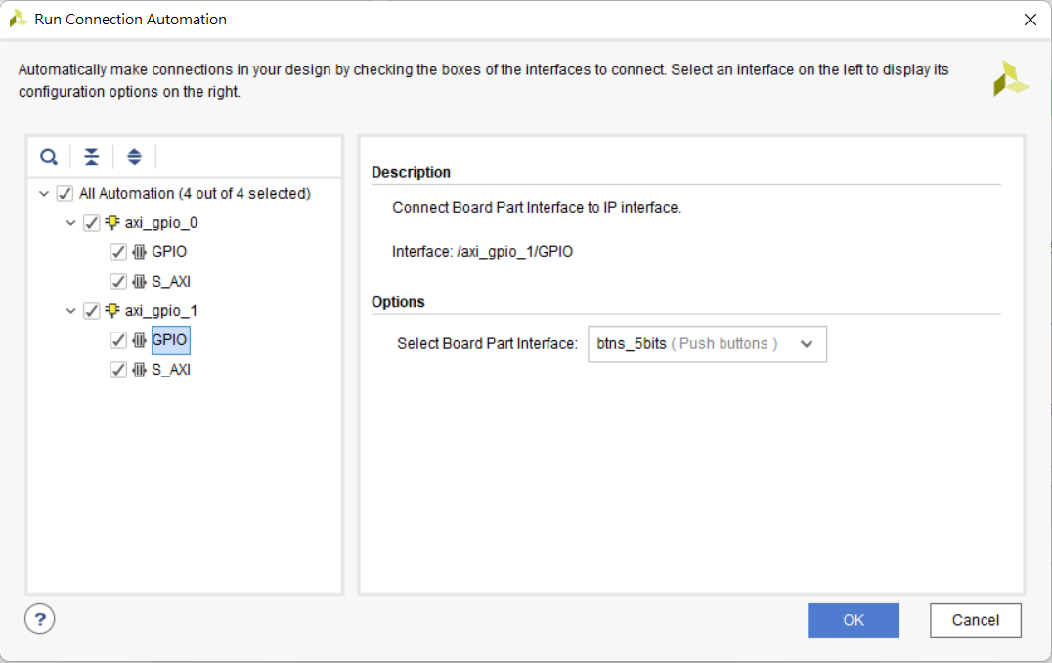
Setting GPIO
設定axi_gpio_0 GPIO Options Select Board Part Interface 為leds_8bits(LED)
設定axi_gpio_1 GPIO Options Select Board Part Interface 為btns_5bits(Puch buttons)
都設定完畢後按下OK

Slide 19
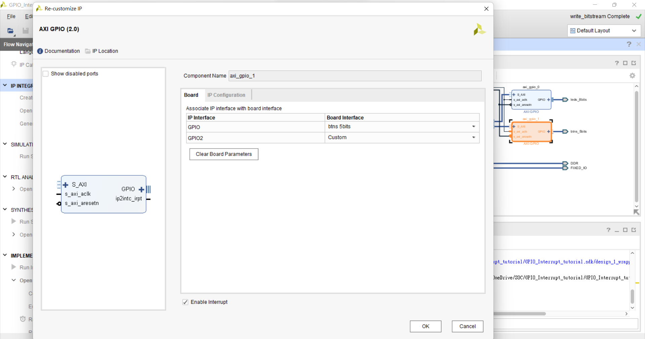
axi_gpio_1 Enable Interrupt

Slide 20
axi_gpio_1 Enable Interrupt

Slide 21
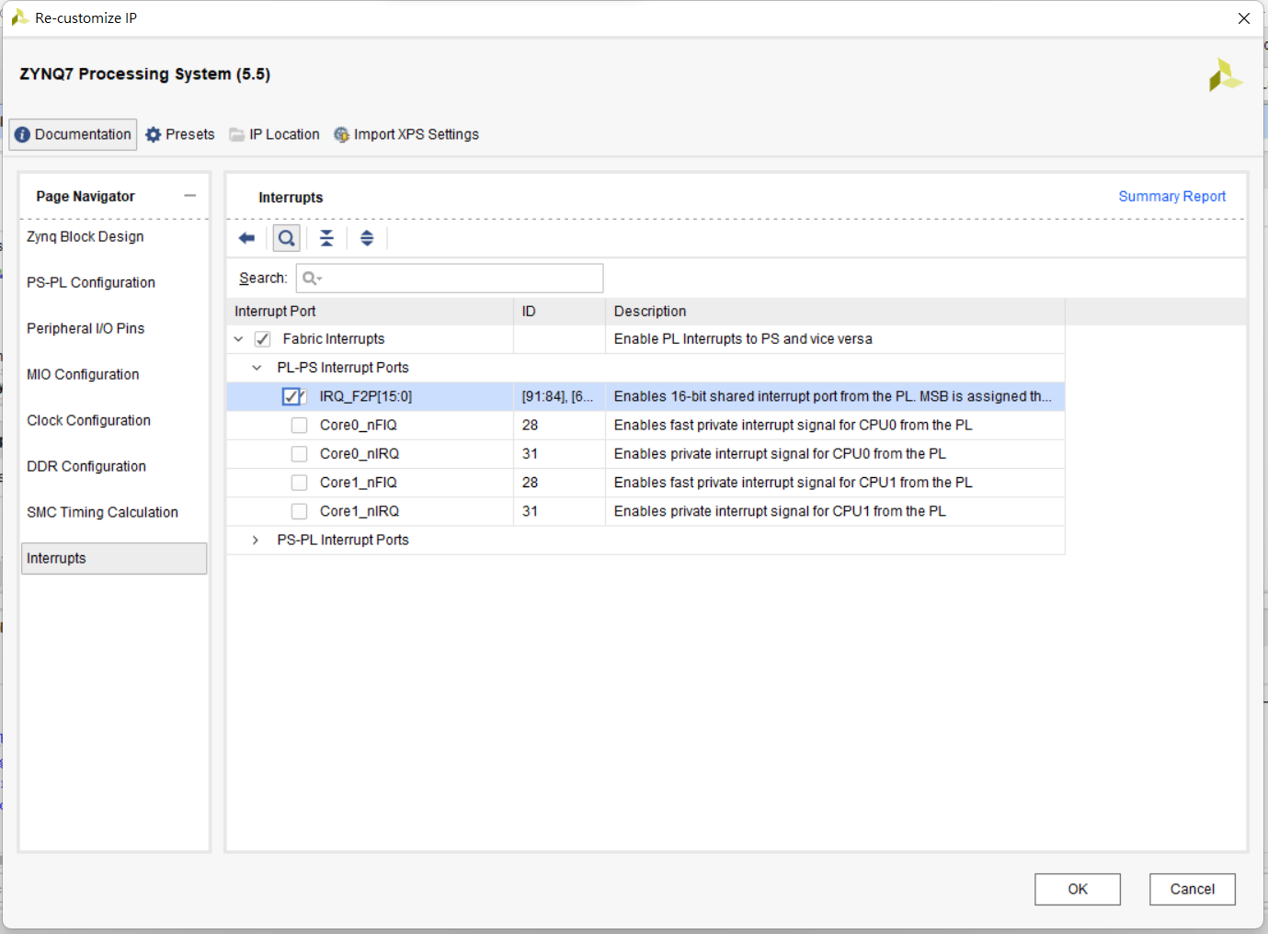
Processing system Enable IRQ

Slide 22
Processing system Enable IRQ

Slide 23
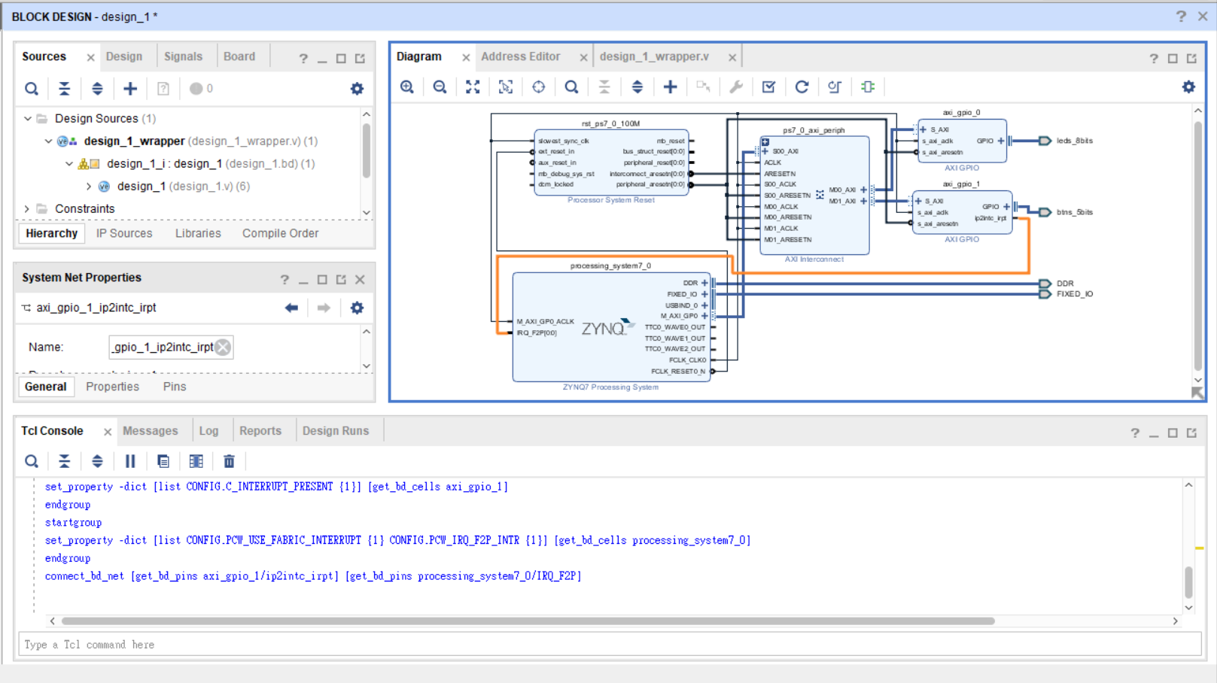
將線路連接起來

Slide 24
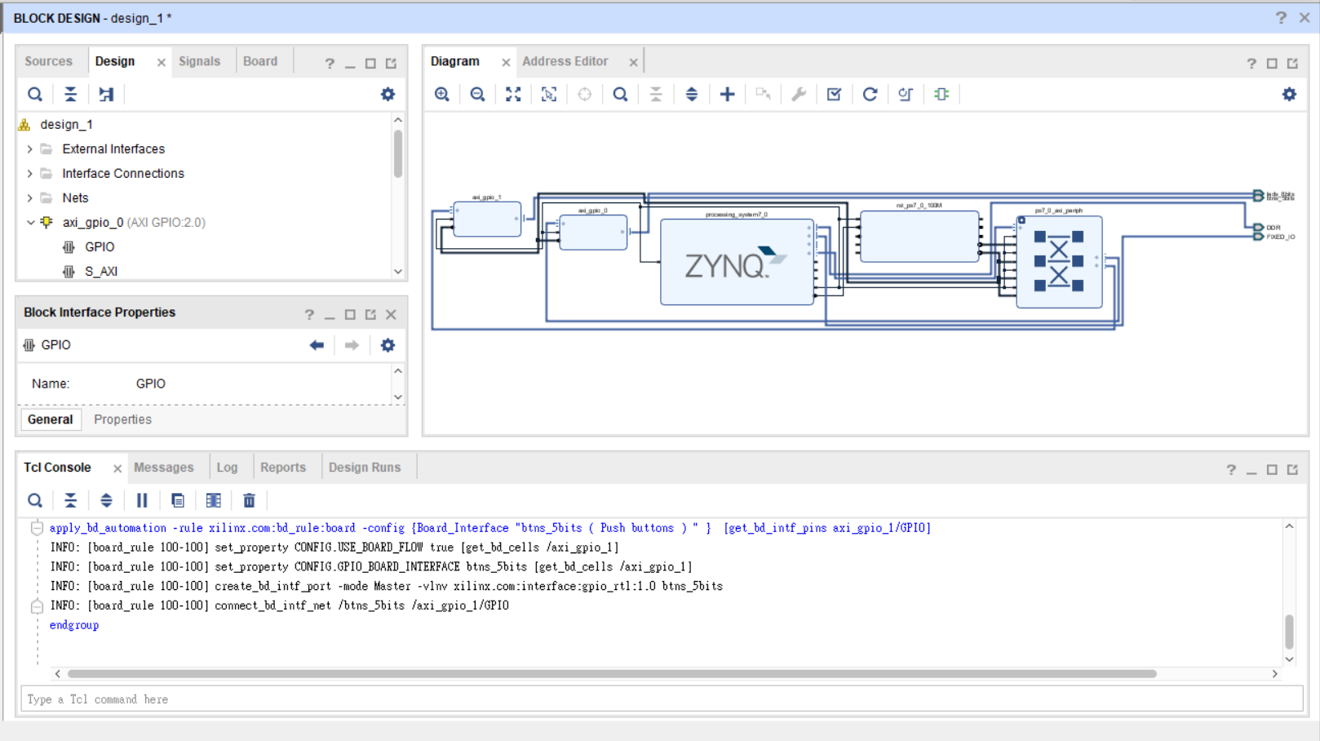
Regenerate layout

Slide 25
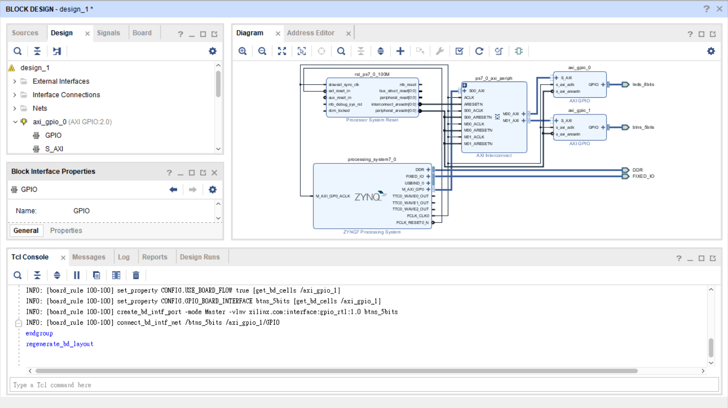
Validation design

Slide 26
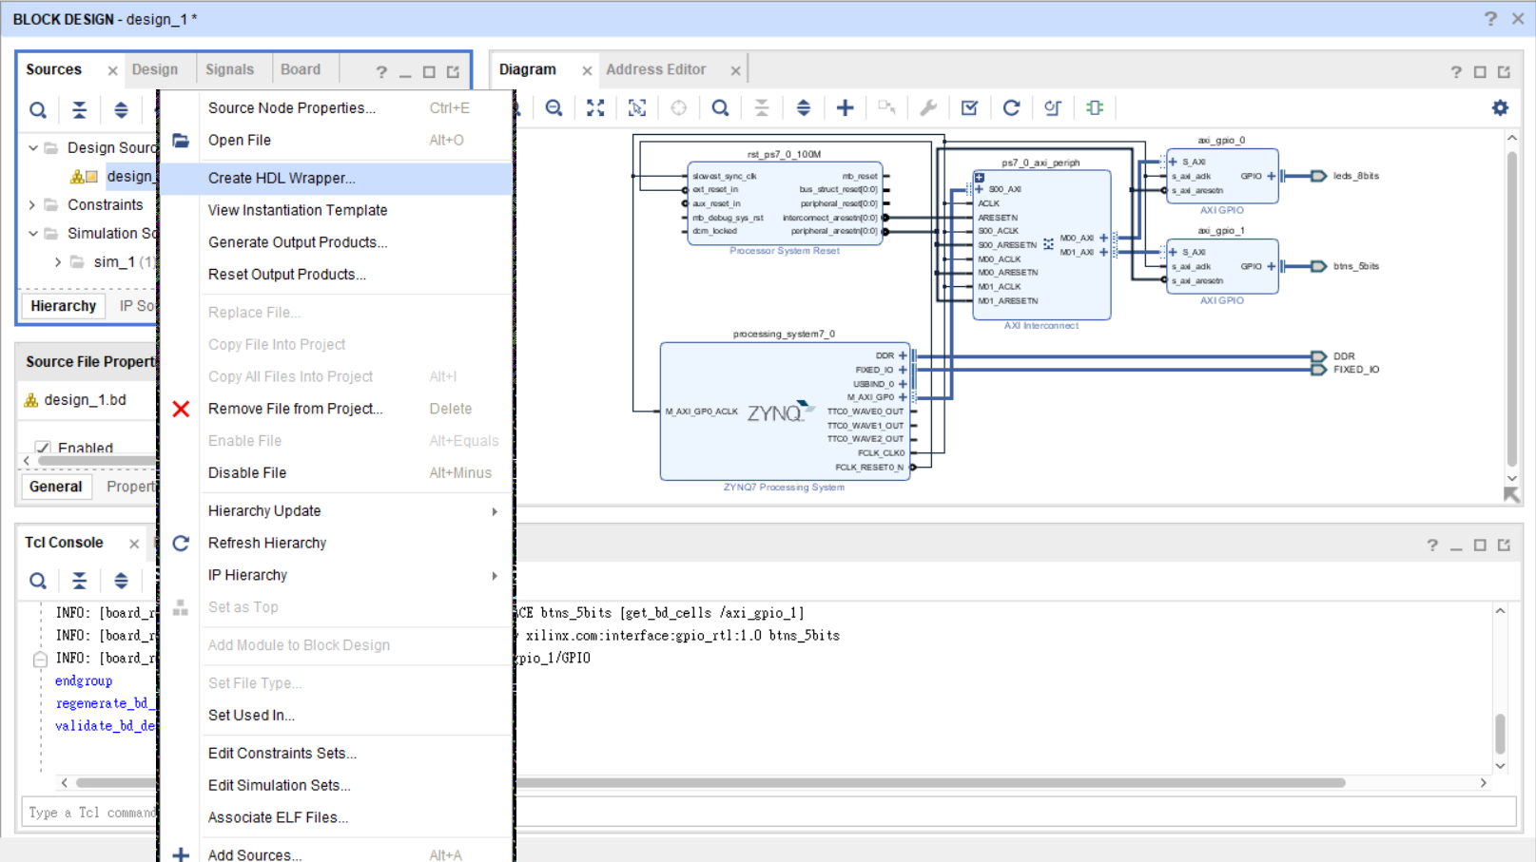
Create HDL wrapper

Slide 27
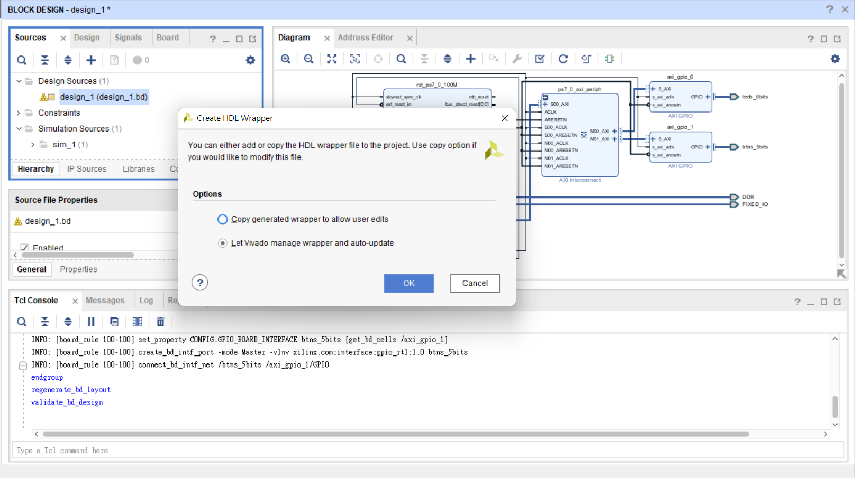

Slide 28
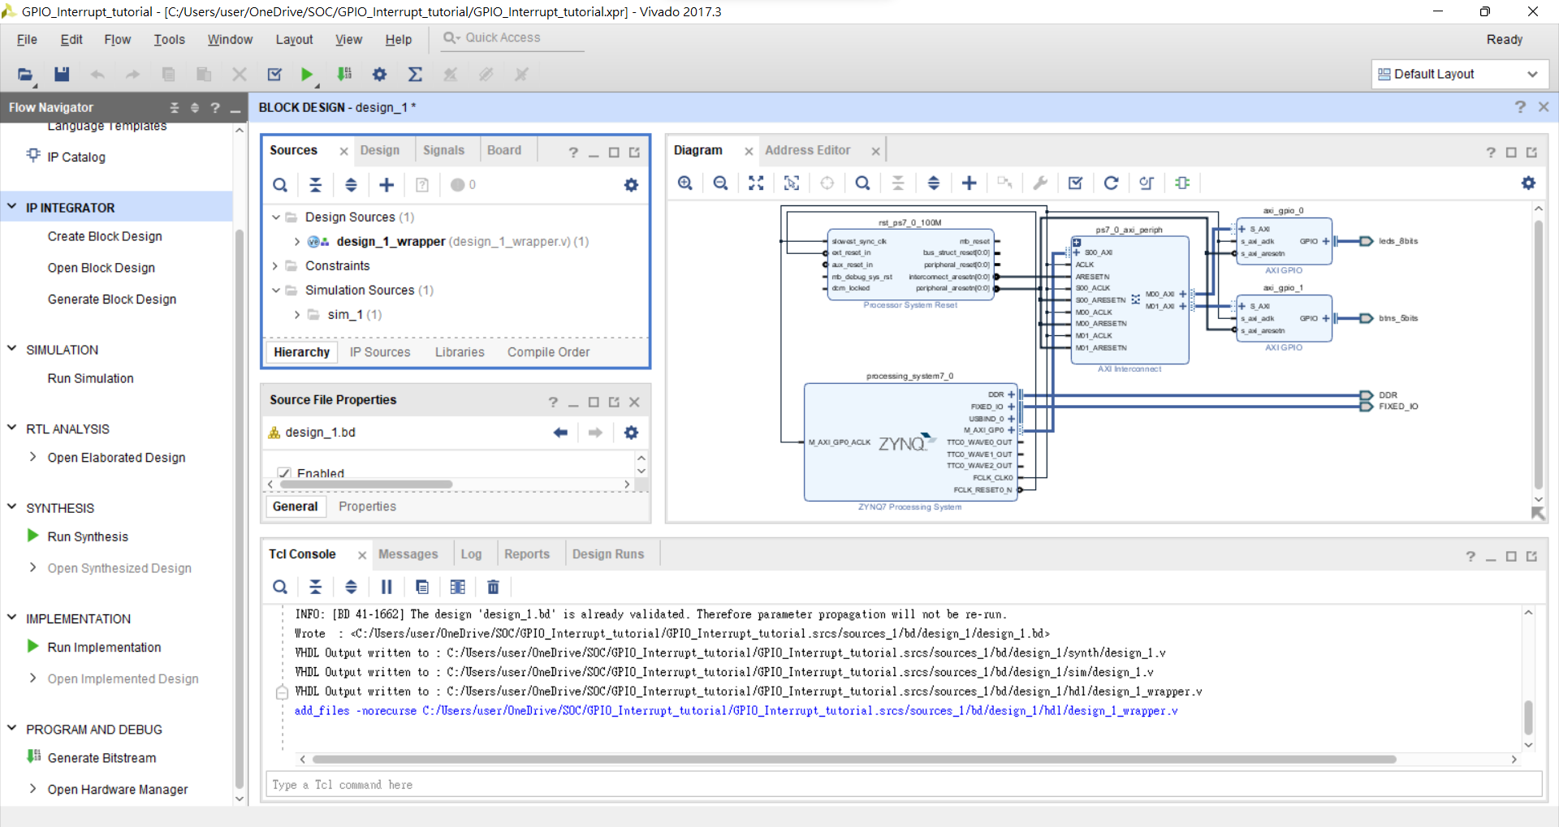
Generate Bitstream

Slide 29
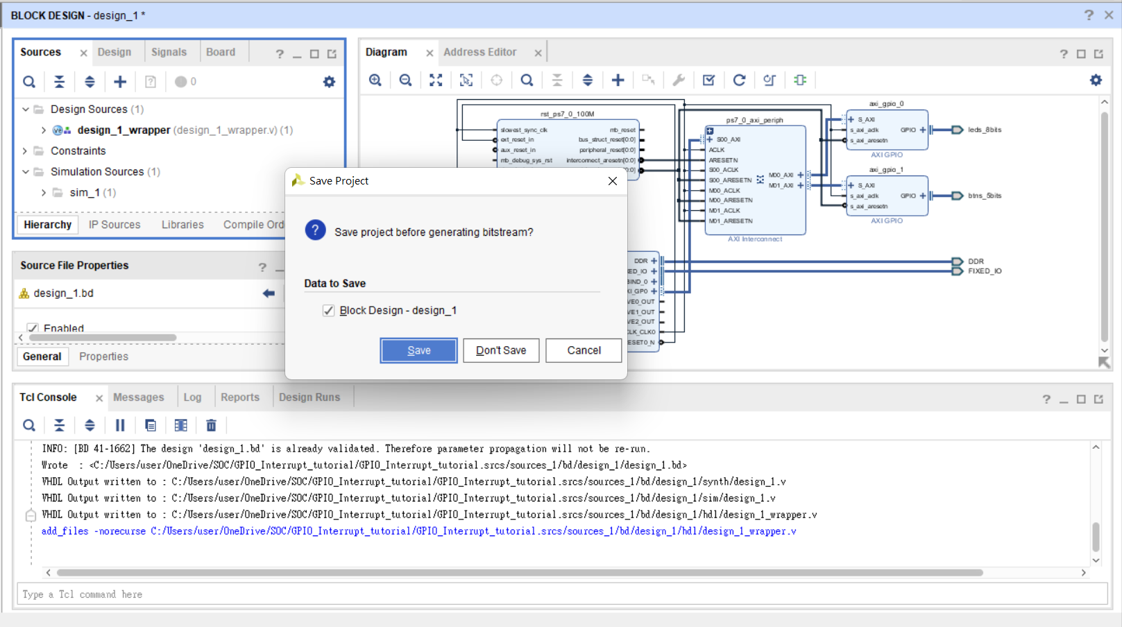

Slide 30
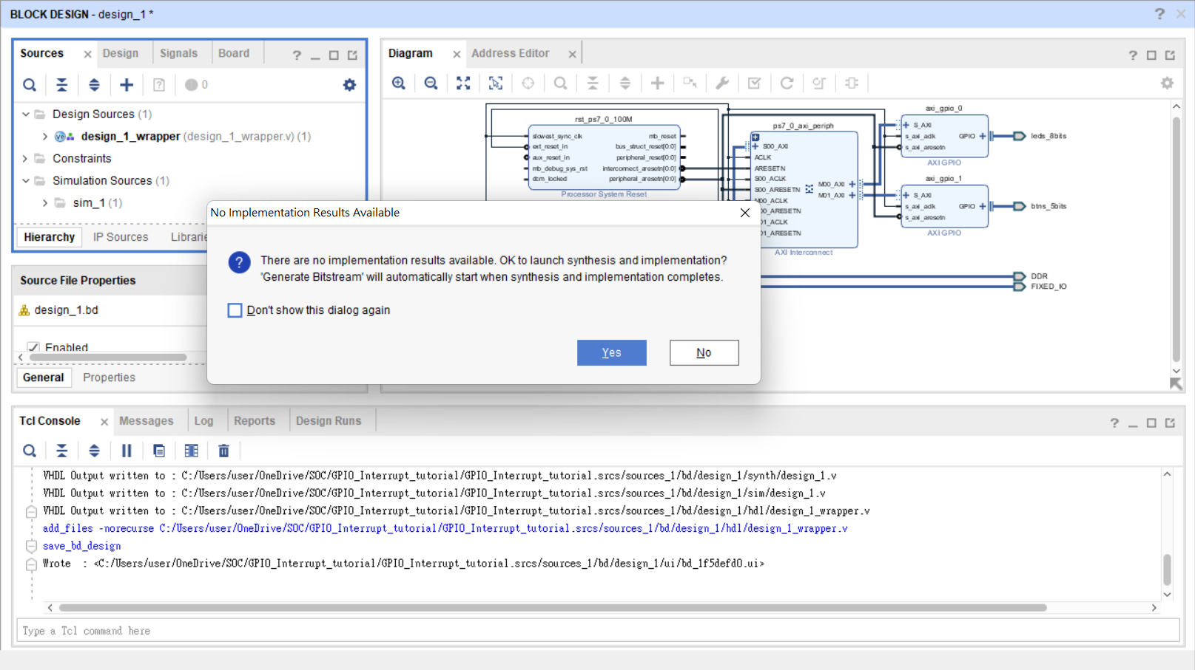

Slide 31
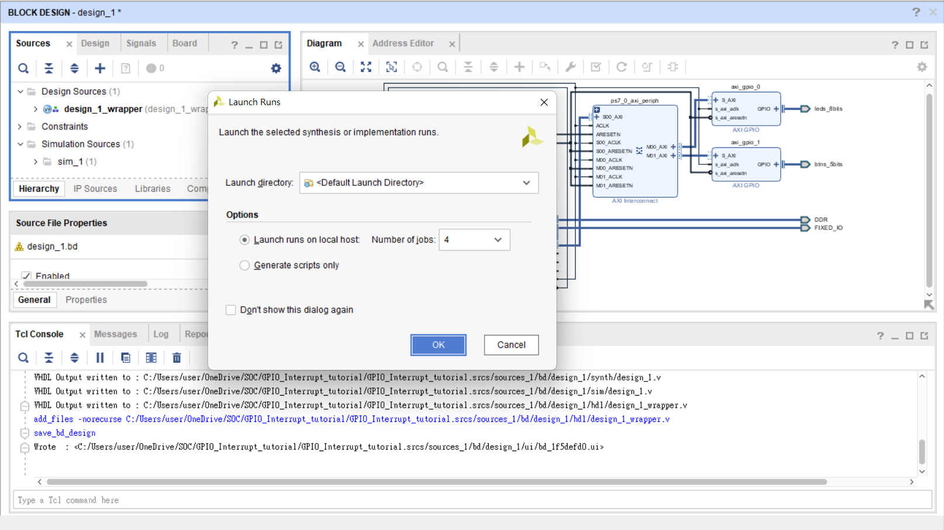

Slide 32
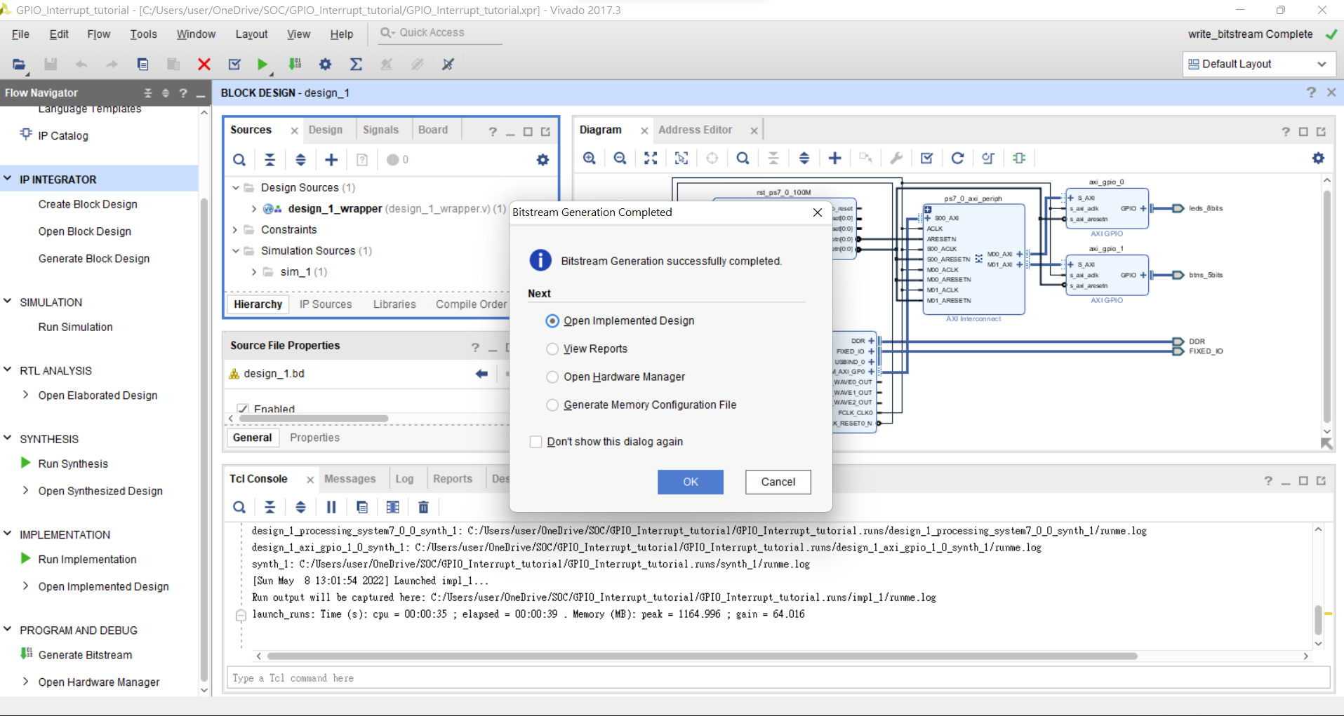

Slide 33
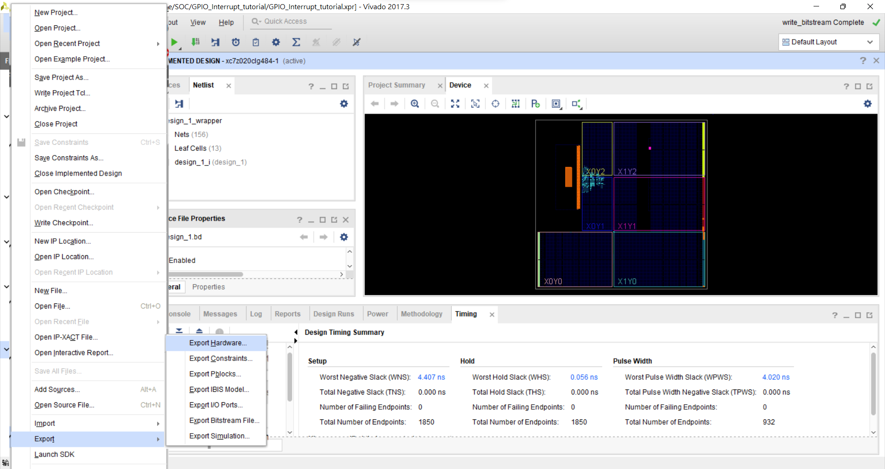
File→Export→Export Hardware

Slide 34
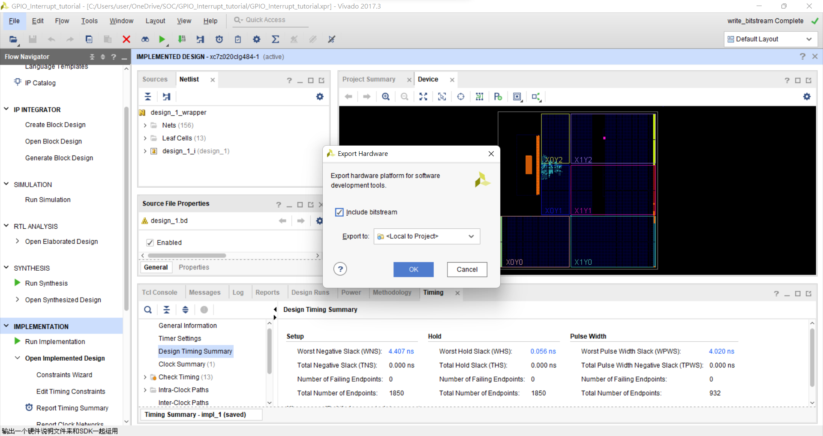

Slide 35
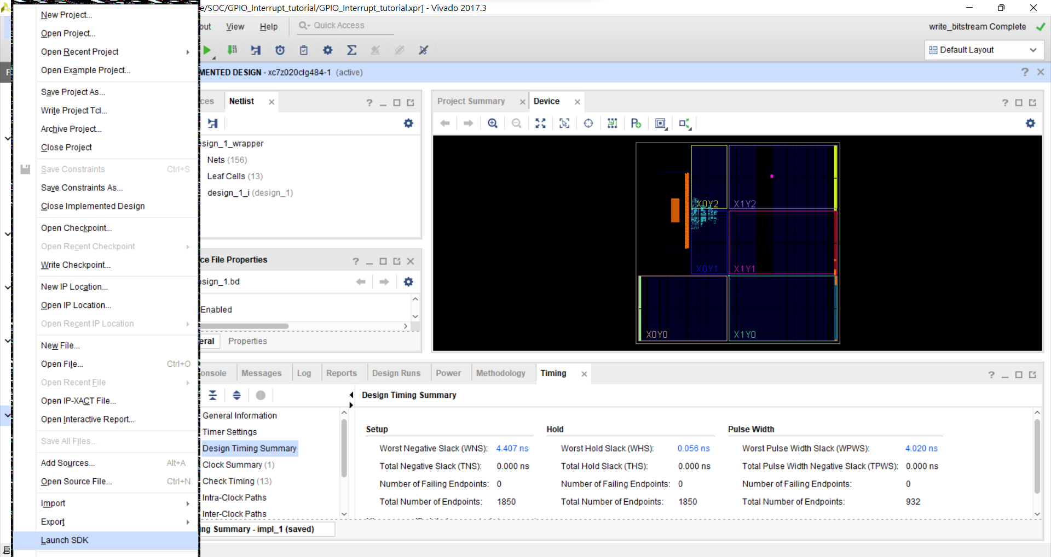
File→ Launch SDK

Slide 36
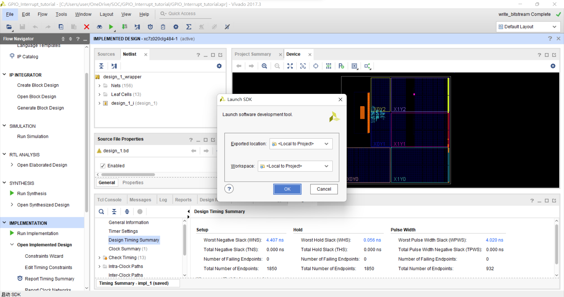

Slide 37
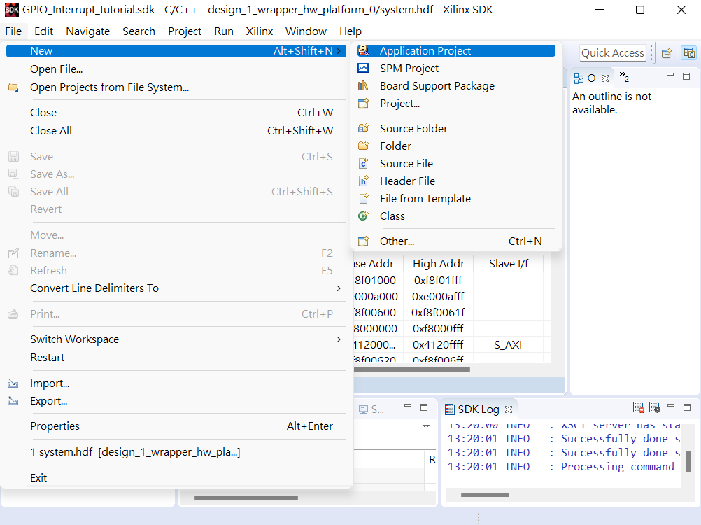
File→New→application project

Slide 38
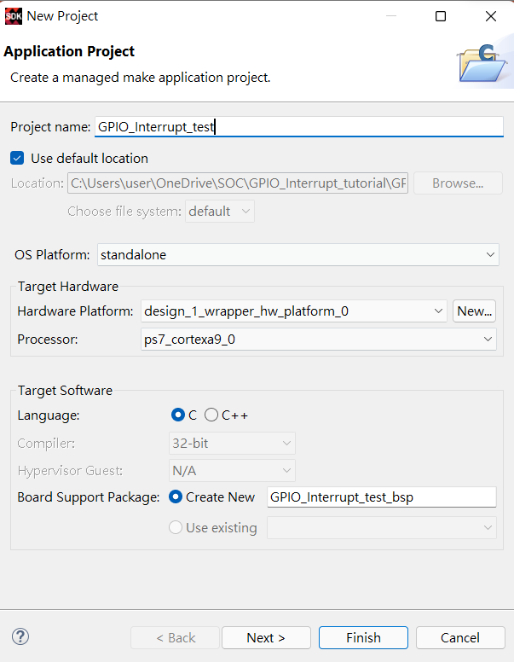
設定專案名稱

Slide 39
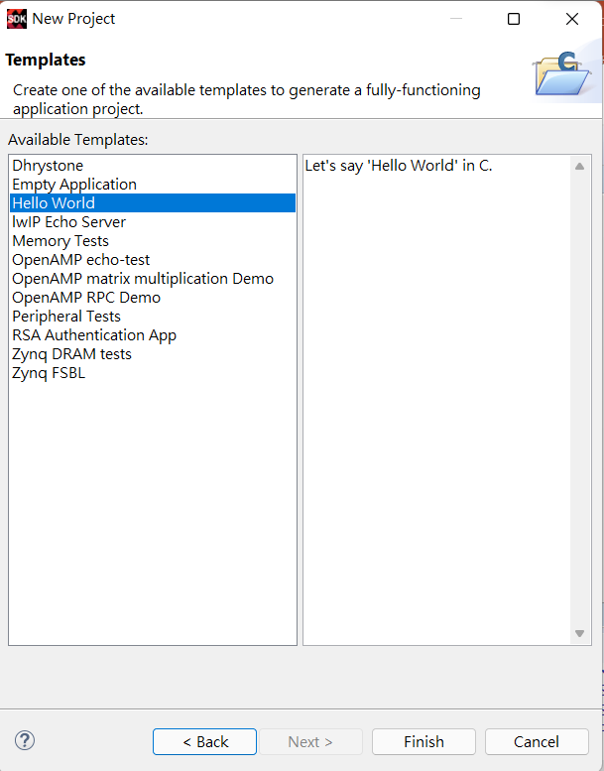
選擇Hello World Template

Slide 40
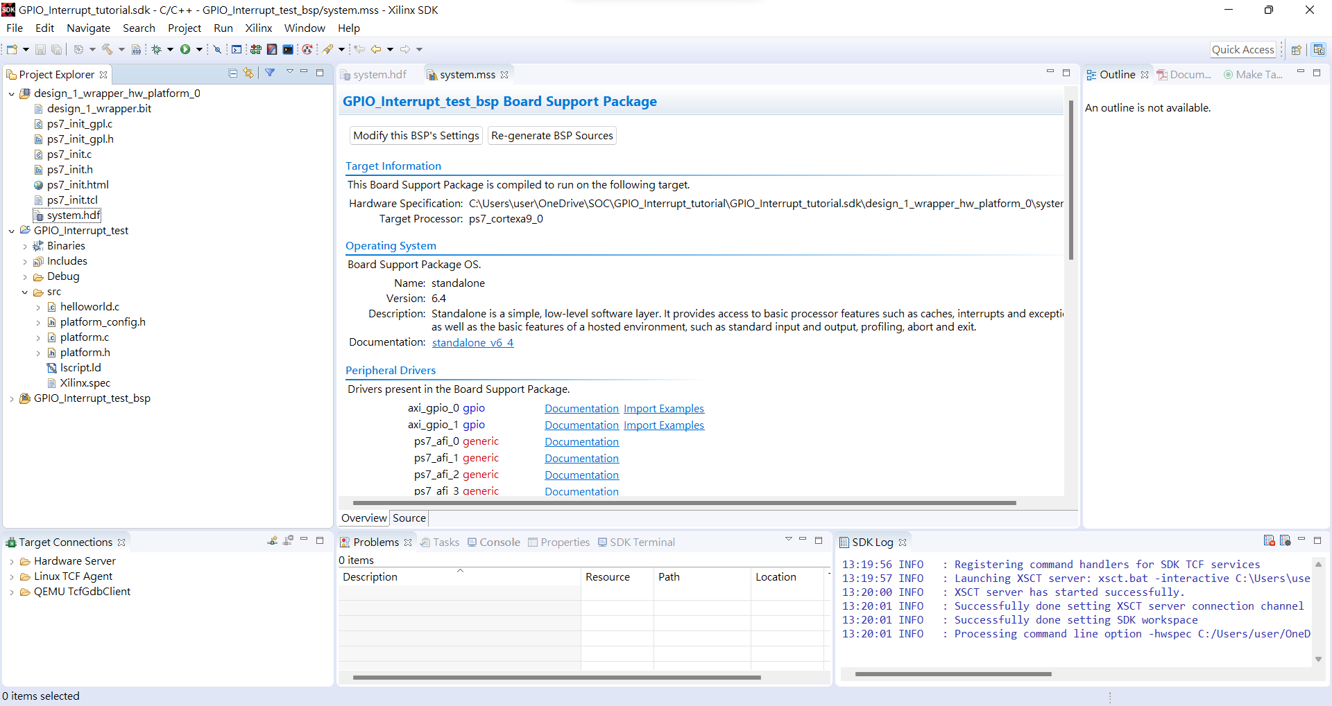
Project Explore →GPIO_Interrupt_test→src→helloworld.c
點兩下編輯

Slide 41
Edit code
Include header file
Parameter definitions
#include <stdio.h>
#include "platform.h“
#include "xparameters.h“
#include "xgpio.h“
#include "xscugic.h“
#include "xil_exception.h“
#include "xil_printf.h"
#define INTC_DEVICE_ID XPAR_PS7_SCUGIC_0_DEVICE_ID
#define BTNS_DEVICE_ID XPAR_AXI_GPIO_1_DEVICE_ID
#define LEDS_DEVICE_ID XPAR_AXI_GPIO_0_DEVICE_ID
#define INTC_GPIO_INTERRUPT_ID XPAR_FABRIC_AXI_GPIO_1_IP2INTC_IRPT_INTR
#define BTN_INT XGPIO_IR_CH1_MASK
XGpio LEDInst, BTNInst;
XScuGic INTCInst;
static int led_data;
static int btn_value;
Reference:GPIO interrupt and processes (xilinx.com)

Slide 42
Edit code
PROTOTYPE FUNCTIONS
static void BTN_Intr_Handler(void *baseaddr_p);
static int InterruptSystemSetup(XScuGic *XScuGicInstancePtr);
static int IntcInitFunction(u16 DeviceId, XGpio *GpioInstancePtr);

Slide 43
Edit code
INTERRUPT HANDLER FUNCTIONS
void BTN_Intr_Handler(void *InstancePtr) {
// Disable GPIO interrupts
XGpio_InterruptDisable(&BTNInst, BTN_INT);
// Ignore additional button presses
if ((XGpio_InterruptGetStatus(&BTNInst) & BTN_INT) != BTN_INT) {
return;
}
btn_value = XGpio_DiscreteRead(&BTNInst, 1);
// Increment counter based on button value
// Reset if centre button pressed
if (btn_value != 1)
led_data = led_data + btn_value;
else
led_data = 0;
XGpio_DiscreteWrite(&LEDInst, 1, led_data);
(void) XGpio_InterruptClear(&BTNInst, BTN_INT);
// Enable GPIO interrupts
XGpio_InterruptEnable(&BTNInst, BTN_INT);
}

Slide 44
Edit code
INITIAL SETUP FUNCTIONS
int InterruptSystemSetup(XScuGic *XScuGicInstancePtr) {
// Enable interrupt
XGpio_InterruptEnable(&BTNInst, BTN_INT);
XGpio_InterruptGlobalEnable(&BTNInst);
Xil_ExceptionRegisterHandler(XIL_EXCEPTION_ID_INT,
(Xil_ExceptionHandler) XScuGic_InterruptHandler,
XScuGicInstancePtr);
Xil_ExceptionEnable();
return XST_SUCCESS;
}

Slide 45
int IntcInitFunction(u16 DeviceId, XGpio *GpioInstancePtr) {
XScuGic_Config *IntcConfig;
int status;
// Interrupt controller initialization
IntcConfig = XScuGic_LookupConfig(DeviceId);
status = XScuGic_CfgInitialize(&INTCInst, IntcConfig, IntcConfig->CpuBaseAddress);
if (status != XST_SUCCESS)
return XST_FAILURE;
// Call to interrupt setup
status = InterruptSystemSetup(&INTCInst);
if (status != XST_SUCCESS)
return XST_FAILURE;
// Connect GPIO interrupt to handler
status = XScuGic_Connect(&INTCInst, INTC_GPIO_INTERRUPT_ID,
(Xil_ExceptionHandler) BTN_Intr_Handler, (void *) GpioInstancePtr);
if (status != XST_SUCCESS)
return XST_FAILURE;
// Enable GPIO interrupts interrupt
XGpio_InterruptEnable(GpioInstancePtr, 1);
XGpio_InterruptGlobalEnable(GpioInstancePtr);
// Enable GPIO and timer interrupts in the controller
XScuGic_Enable(&INTCInst, INTC_GPIO_INTERRUPT_ID);
return XST_SUCCESS;
}

Slide 46
main
int main()
{
init_platform();
int status;
status = XGpio_Initialize(&LEDInst, LEDS_DEVICE_ID); // Initialise LEDs
if (status != XST_SUCCESS)
return XST_FAILURE;
status = XGpio_Initialize(&BTNInst, BTNS_DEVICE_ID); // Initialise Push Buttons
if (status != XST_SUCCESS)
return XST_FAILURE;
XGpio_SetDataDirection(&LEDInst, 1, 0x00); // Set LEDs direction to outputs
XGpio_SetDataDirection(&BTNInst, 1, 0xFF); // Set all buttons direction to inputs
status = IntcInitFunction(INTC_DEVICE_ID, &BTNInst); // Initialize interrupt controller
if (status != XST_SUCCESS)
return XST_FAILURE;
while (1);
cleanup_platform();
return 0;
}

Slide 47
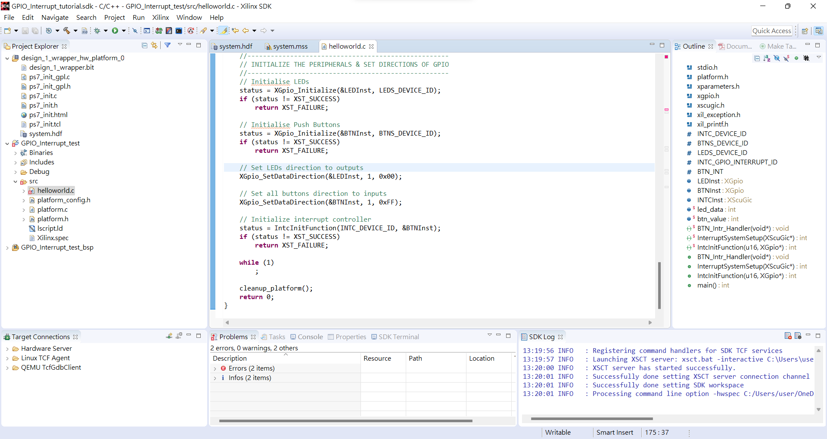
Program FPGA

Slide 48
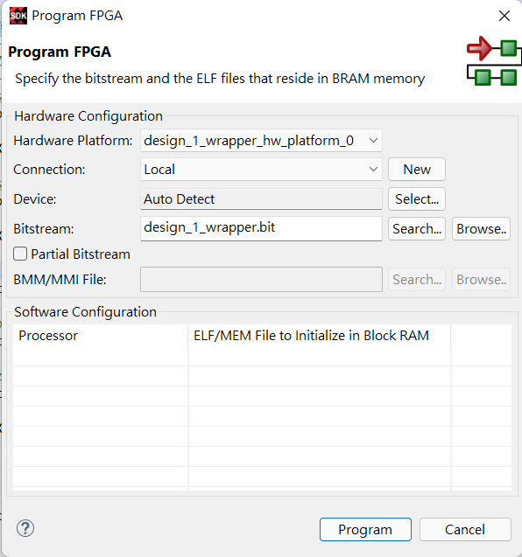

Slide 49
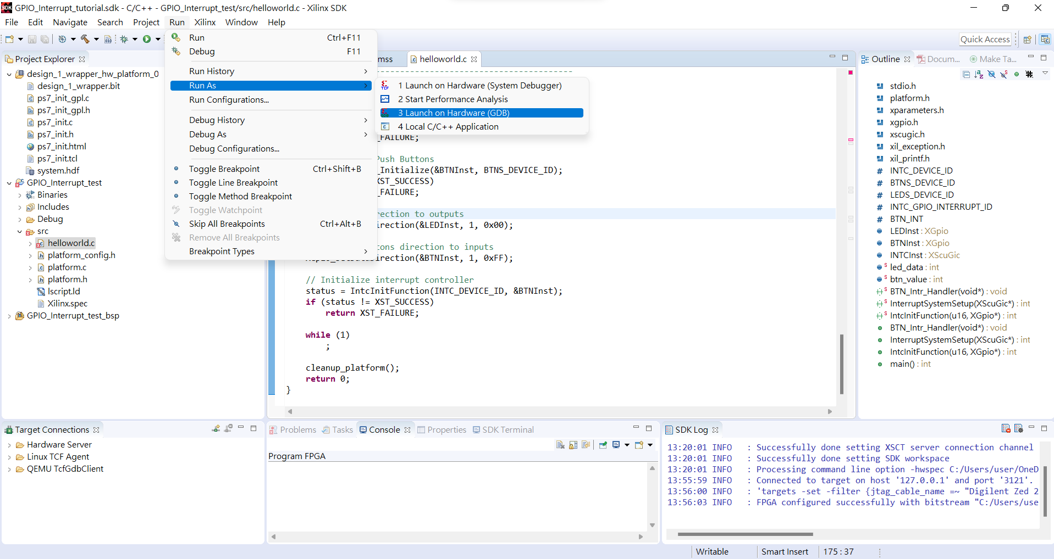
Run → Run As → Launch on Hardware(GDB)

Slide 50
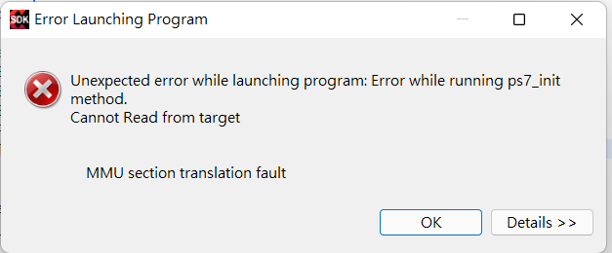
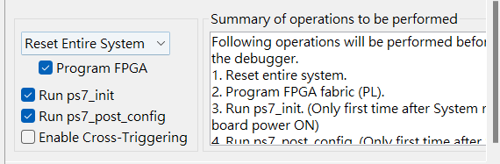
如果出現這種狀況到Run → Run configuration 修改成Reset Entire System

Slide 51
額外補充

Slide 52
程式流程
1.Initialize interrupt controller driver(初始化GIC register base address)
→ Call XScuGic_LookupConfig
初始化DeviceId
初始化CpuBaseAddress(ICC address)
初始化DistBaseAddress(ICD address)
初始化HandlerTable = NULL
2.GIC registers initialization
初始化Handler Table 的CallbackRef、Handler
關閉GIC(XScuGic_Stop)
初始化Distributor register(DistributorInit())
初始化GIC CPU Interface register(CPUInitialize())

Slide 53
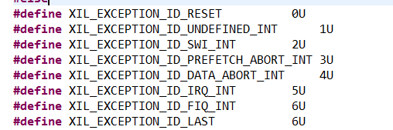
程式流程
3.Connect interrupt controller driver to hardware interrupt logic to processor
(中斷對應的GIC通用中斷處理函數)(將GIC加入核心中斷向量表)
為例外狀況加入相對應的處理函式
發生例外狀況時執行XScuGic_InterruptHandler
XScuGic_InterruptHandler執行
Assert that the pointer to the instance is valid
Read the int_ack register to identify the highest priority interrupt ID and make sure it is valid. Reading Int_Ack will clear the interrupt in the GIC.
execute the ISR. Jump into the Interrupt service routine based on the IRQSource. A software trigger is cleared by the ACK.
4.Connect Interrupt to handler
設定指定IRQ的ISR的位址
Cortex-A 中斷向量表

Slide 54
程式流程
5.開啟指定中斷ID的GIC，通過設定ISDISER (中斷對應的GIC通用中斷處理函數)(將GIC加入核心中斷向量表)
為例外狀況加入相對應的處理函式
發生例外狀況時執行XScuGic_InterruptHandler
6.Connect Interrupt to handler
設定指定IRQ的ISR的位址
Read the interrupt enable register and only enable the specified interrupts without disabling or enabling any others.

Slide 55
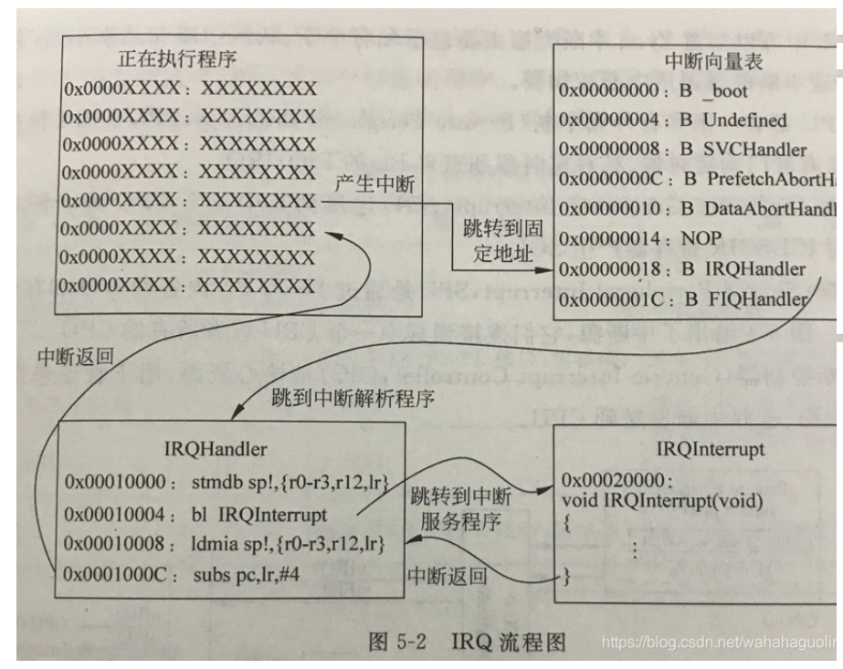

Slide 56
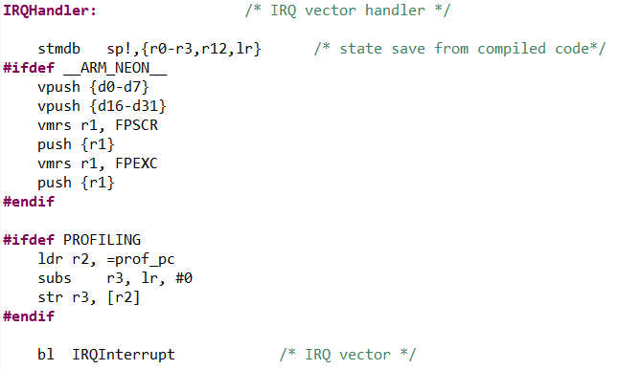
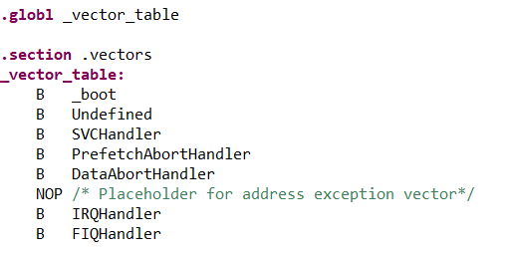
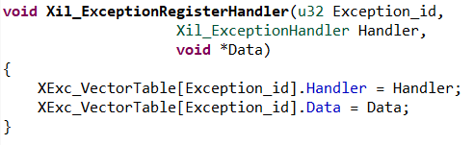
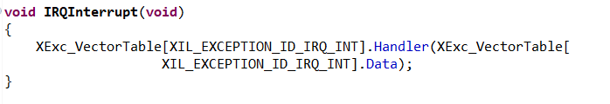
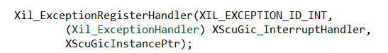
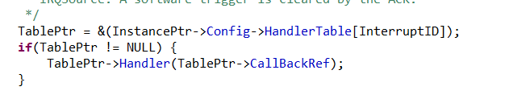
中斷發生時….
ps7_cortexa9_0/libsrc/standalone_v6_5/src/asm_vectors.S
PC 會指向Vector table ，CPU會Jump到中斷向量表的IRQ
ps7_cortexa9_0/libsrc/standalone_v6_5/src/vectors.S
透過Xil_ExceptionRegisterHandler指定Handler
Handler透過呼叫XSuGic_Connect設定
統一由XScu_Gic_InterruptHandler處理

Slide 57
Interrupt register overview
Interrupt Controller CPU (ICC)
Interrupt Controller Distributor (ICD)
ICCICR: CPU interface control
ICCDCR: Secure/non-secure mode select
ICCPMR: Interrupt priority mask
ICDICTR,ICDIIDR: Controller implementation
ICDISER[2:0]
ICDICER[2:0]
ICCBPR: Binary point for interrupt priority
Interrupt set-enable and clear-enable
ICCIAR: Interrupt acknowledge
ICDISER[2:0]
ICDICPR[2:0]
Interrupt set-pending and clear-pending
ICCEOIR: End of Interrupt
ICDABR[23:0]: Interrupt active
ICCRPR: Running priority
ICDIPR: Interrupt priority, 8-fields. Only the upper 5 bits of each
8-bit field are writable ; the lower bits are always 0.
There are 32 priority levels.
ICCHPIR: Hightest pending interrupt
ICDIPTR[23:0]: Interrupt processor targets, 8-bit fields
ICCABPR: Aliased non-secure binary point
ICDICFR[5:0]: Interrupt sensitivity type, 2-bit fields
(level/edge, handling model)

Slide 58
PPI and SPI Status
PPI_STATUS
PPI status:
Corresponds to ICDISR[0], ICDISER[0], ICDICER[0],
ICDISPR[0], ICDICPR[0], and ICDABR[0] registers (security,
enable, pending and active).
SPI_STATUS[2:1]
SPI status:
Corresponds to ICDISR[2:1], ICDISER[2:1],
ICDICER[2:1], ICDISPR[2:1], ICDICPR[2:1], and ICDABR[2:1]
registers (security, enable, pending and active).

Slide 59
Software Generated Interrupts(SGI)
ICDSGIR
Software-generated interrupts
Disable Write Accesses(SLCR register)
APU_CTRL
CFGSDISABLE bit disables some write accesses

Slide 60
Reference
Problem with ps7_init (xilinx.com)
Xilinx Zynq Vivado GPIO Interrupt Example – YouTube
GPIO interrupt and processes (xilinx.com)
ARM的規則ATPCS和AAPCS | 程式前沿 (codertw.com)
（四）Zedboard上面實現按鍵中斷 - 台部落 (twblogs.net)
Zynq-PS-SDK(4) 之 GIC 配置_爱洋葱的博客-CSDN博客_regoffset

